Slide 1






PROJECT 1: Serverless Image Processing
Project 2 : Deploy a Static Website on AWS
Group members :
ANUSHKA YADAV
ARPITA DWIVEDI
MADHURAG TRIPATHI
TUSHAR SHARMA

Slide 2


Project 1:
SERVERLESS IMAGE PROCESSING

Slide 3
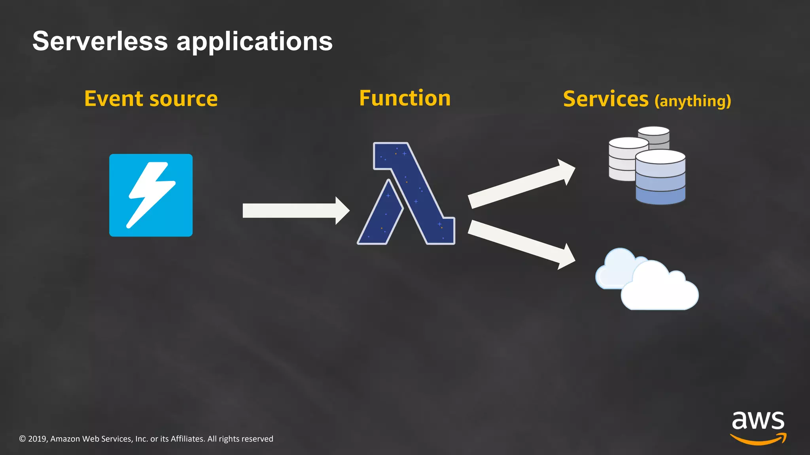
Introduction
Serverless Image Processing is a modern and efficient approach to handle image processing tasks without managing traditional server infrastructure. Amazon Web Services (AWS) offers a powerful combination of AWS Simple Storage Service (S3) and AWS Lambda, providing a scalable and cost-effective solution for image processing workflows.

Slide 4

Aws lamda:
AWS Lambda is an event-driven, serverless computing platform provided by Amazon as a part of Amazon Web Services. It is a computing service that runs code in response to events and automatically manages the computing resources required by that code. It was introduced on November 13, 2014.

Slide 5
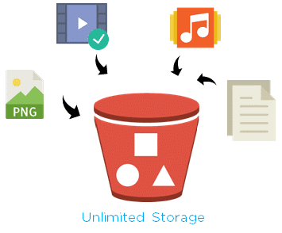
AWS S3 - The Scalable Storage Solution
Amazon S3 is a secure, durable, and highly scalable object storage service provided by AWS. It allows you to store and retrieve any amount of data at any time. For our image processing workflow, S3 plays a crucial role as the primary storage for the images. Lambda functions will be triggered by events on the S3 bucket, enabling us to process images on the fly.

Slide 6
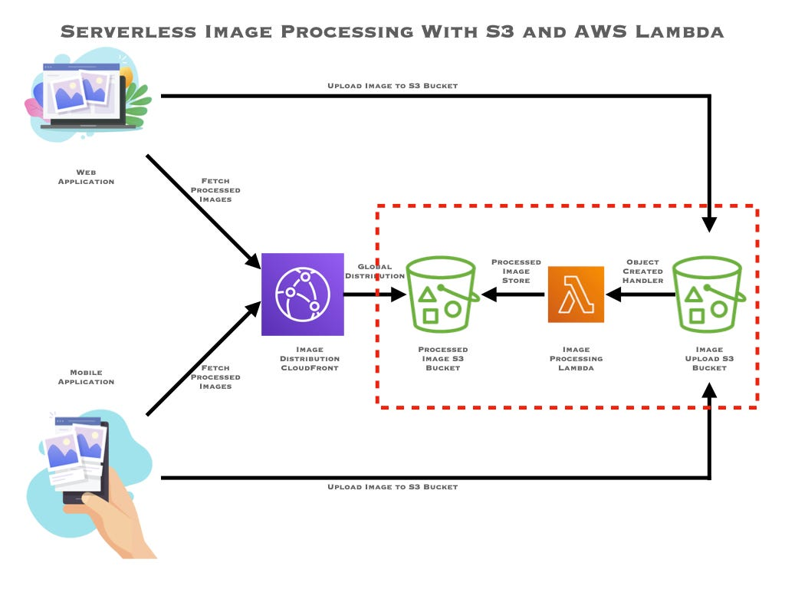

Slide 7
Image Processing Workflow
1. Image Upload: Users upload images to the S3 bucket.
2. S3 Event Trigger: S3 generates an event when an image is uploaded.
3. Lambda Invocation: The Lambda function is automatically invoked in response to the S3 event.
4. Image Processing: The Lambda function processes the image using custom logic and/or third-party libraries.
5. Processed Image Storage: The processed image is stored back in the S3 bucket or any other desired location.
6. Optional: Notification: Optionally, a notification can be sent to users or other systems upon successful image processing.

Slide 8
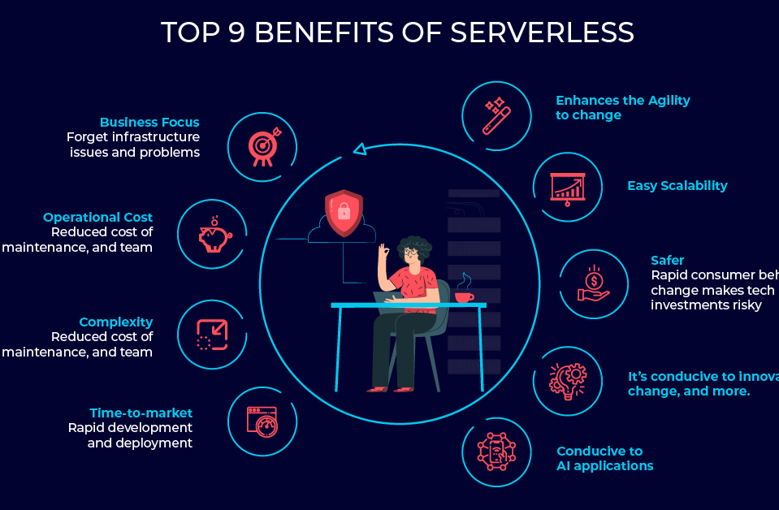
Benefits of serverless
Scalability: Serverless platforms automatically scale resources based on demand, ensuring that image resizing can handle varying workloads without manual intervention.
Cost Efficiency: You only pay for the actual processing performed, reducing costs during periods of low activity. This cost model can be more economical compared to maintaining dedicated servers.
Resource Optimization: Serverless platforms often optimize resource utilization, ensuring efficient image resizing processes.
Resource Optimization: Serverless platforms often optimize resource utilization, ensuring efficient image resizing processes.

Slide 9
Various use cases of S3 and lambda :
• Image Thumbnail Generation:Automatically create thumbnails of uploaded images for use in galleries, product listings, or social media profiles.
Image Filtering and Manipulation: Apply filters, resize, crop, or rotate images based on user preferences or application requirements.
Real-Time Image Processing: Process images in real-time for applications. like augmented reality, virtual makeup try- ons, or interactive image filters.
• Image Optimization: Compress and. optimize images to reduce file sizes while maintaining acceptable quality. for faster website loading and. improved user experience.

Slide 10
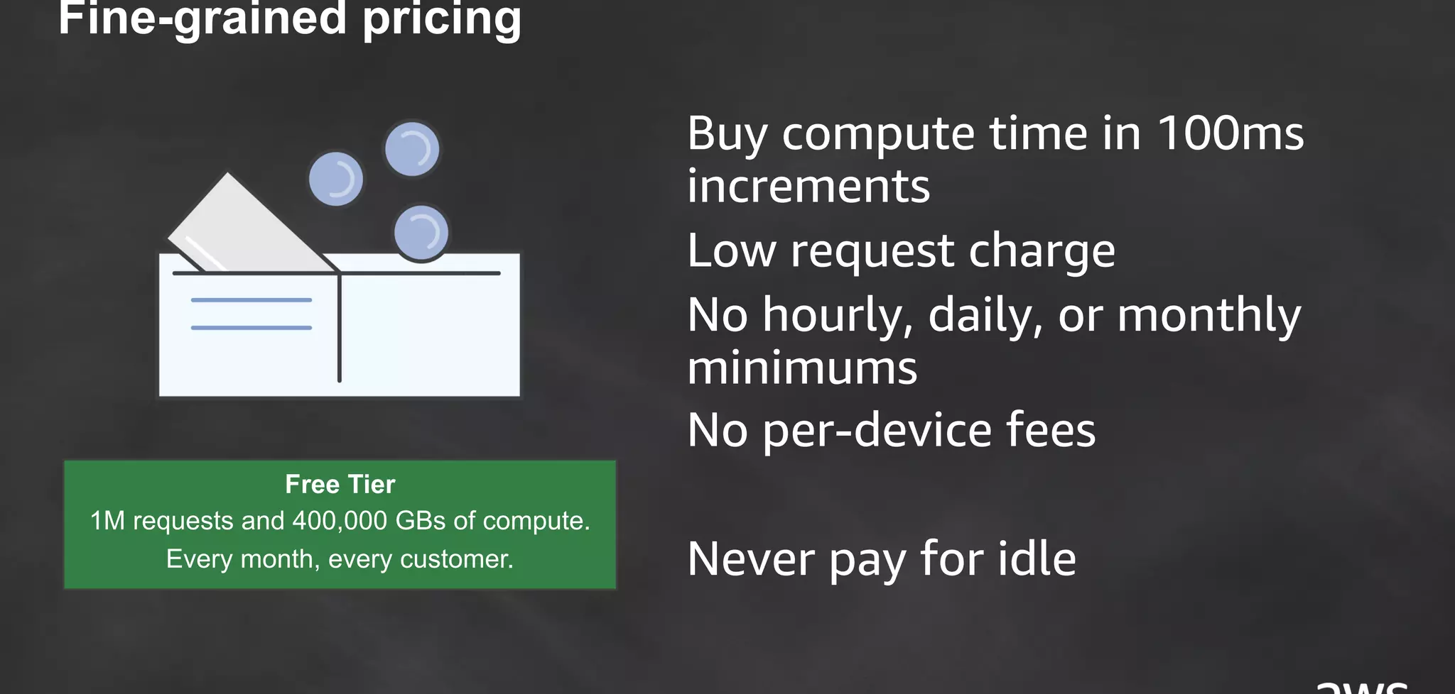

Slide 11
Project 2:
DEPLOY A STATIC WEBSITE ON AWS

Slide 12
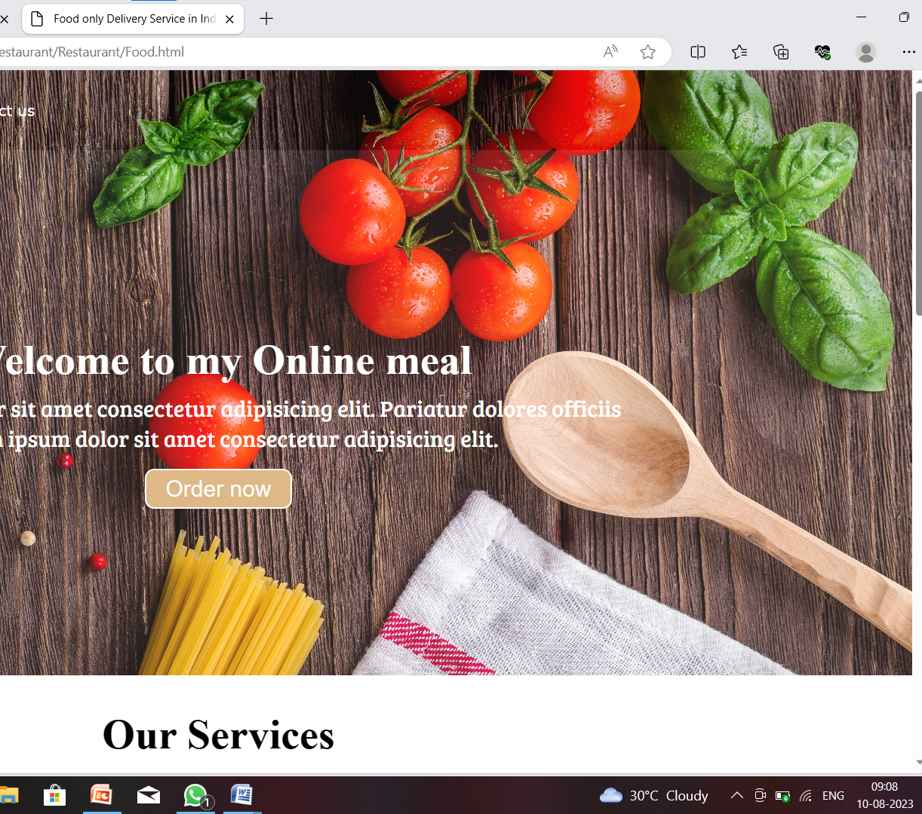
FOOD ONLY DELIVERY SERVICE IN INDIA
https://static-server9936.s3.ap-south-1.amazonaws.com/Restaurant/Restaurant/Food.html

Slide 13
HOSTING STATIC WEBSITE ON S3
Create an S3 Bucket: First, create a new S3 bucket and give it a globally unique name. This name will be part of the URL for your website.
Configure Bucket for Static Website Hosting: In the S3 bucket settings, enable "Static website hosting" and specify the index and error documents (usually "index.html" and "error.html").
Upload Website Content: Upload your static website's HTML, CSS, JavaScript, and other assets into the S3 bucket. Make sure to maintain a folder structure if your website has multiple pages or assets.
Set Permissions: Make your content publicly accessible by configuring the bucket's permissions. You can use a Bucket Policy or Access Control Lists (ACLs) to allow public read access.
Enable Static Website Hosting: Once your content is uploaded and permissions are set, the S3 bucket will provide you with a URL. This URL will be the endpoint to access your static website.

Slide 14

Benefits of using s3 for hosting static website :
Reliability and Durability: S3 offers 99.999999999% (11 nines) durability for your stored objects. This means your website files are highly resilient and protected against data loss.
Cost-Effective: Hosting a static website on S3 is cost-effective, as you only pay for the storage you use and the data transfer. There's no need to worry about server provisioning or management costs.

Slide 15

USE CASES OF DEPLOYING STATIC WEBSITE:
Personal/Blog Site: Host a personal blog or portfolio to showcase your work or share your thoughts.
Business Landing Page: Create a professional landing page to display information about your business, products, and services.
Documentation: Host documentation for your projects or products, making it accessible to users and developers.
Event Websites: Set up websites for conferences, seminars, or other events to provide information and registration options.

Slide 16

Conclusion
In conclusion, Serverless Image Processing in AWS using S3 and Lambda offers a powerful and cost-effective solution for handling image processing tasks. Leveraging the scalability of AWS S3 and the compute capabilities of AWS Lambda, we can build efficient and flexible workflows that process images on demand without the need for managing servers. This serverless approach enables faster development, reduced maintenance, and optimized cost structures, making it an ideal choice for various image processing applications.

Slide 17

Thank you

